Slide 1
Facial Emotion Recognition
Team Members:
Isha Hemant Arora
Bala Sirisha Sripathi Panditharadhyula
Amulya Gupta Vangapalli

Slide 2
INTRODUCTION
Facial Emotion Recognition (FER) is the technology that analyses facial expressions from static images in order to reveal information on one's emotional state.
Facial expressions can be classified into neutral, anger, fear, surprise, sad, and happy.
Through facial emotion recognition, we are able to measure the effects that content and services have on the audience/users through an easy and low-cost procedure.
Facial expression recognition is important because gestures convey nonverbal communication cues that play an important role in interpersonal relations..

Slide 3
AGENDA
Exploratory Data Analysis
Data Pre-processing
Modelling and Evaluation
Results

Slide 4
EXPLORATORY DATA ANALYSIS
This dataset contains static images sorted into folders pertaining to different expressions of the human face, namely, Surprise, Anger, Happiness, Sad, Neutral, Disgust, Fear.
The training set consists of 28,273 samples in total while the testing set consisting of 7,067 samples in total.
The data consists of 48x48 pixel grayscale images of faces.

Slide 5
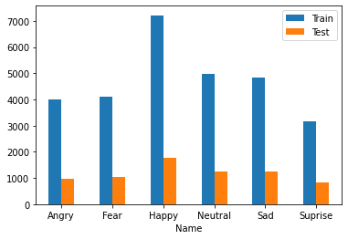
EXPLORATORY DATA ANALYSIS
Class wise Train – Test distribution
The train data contains: 7215 Happy images 4097 Fear images 4830 Sad images 3995 Angry images 4965 Neutral images 3171 Surprise images
The test data contains 1774 Happy images 1024 Fear images 1247 Sad images 958 Angry images 1233 Neutral images 831 Surprise images

Slide 6
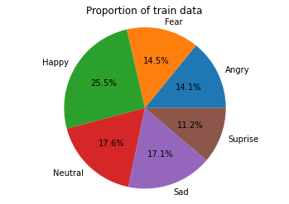

EXPLORATORY DATA ANALYSIS

Slide 7
DATA PRE_PROCESSING
The dlib library is a library that can be used to determine 68 facial landmarks in a human face using a pre-trained landmark detector. These points localize the region around the eyes, eyebrows, nose, mouth, chin and jaw.
The dlib function get_frontal_face_detection() has been used for face detection.
An array highlighting the 68 facial landmarks is retrieved and used while fitting the models.

Slide 8
MODELS IMPLEMENTED
Decision Tree
Random Forest
K Nearest Neighbours (KNN)
Gaussian Naïve Bayes
Convolutional Neural Networks – VGG16

Slide 9
Decision Tree Classifier
Decision Trees are a type of Supervised Machine Learning where the data is continuously split according to a certain parameter.
Hyperparameter Tuning:
Random State=7,
Maximum Depth=30,
Minimum number of samples required to split an internal node=50,
Minimum number of samples required to be at a leaf node=93
Evaluation Metrics for Decision Tree:
Precision: 0.25
Recall: 0.23
F1 score: 0.18
Accuracy: 0.29

Slide 10
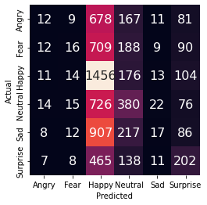
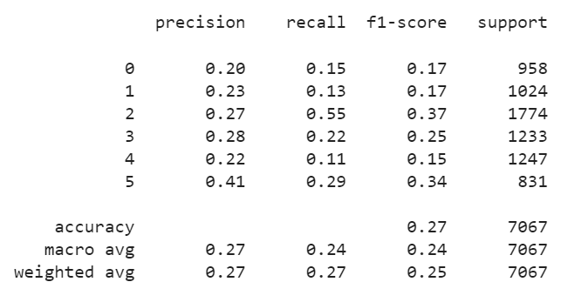
Confusion Matrix
Classification Report as per class

Slide 11
Random Forest Classifier
Random forest, like its name implies, consists of a large number of individual decision trees that operate as an ensemble.
Tuned Hyperparameters:
Number of Estimators=100
Random State=9,
Minimum Samples Split = 5,
Minimum Samples Leaf = 1,
Maximum Depth = 86
Evaluation Metrics for Random Forest Classifier:
Precision: 0.59
Recall: 0.29
F1 score: 0.26
Accuracy : 0.35

Slide 12
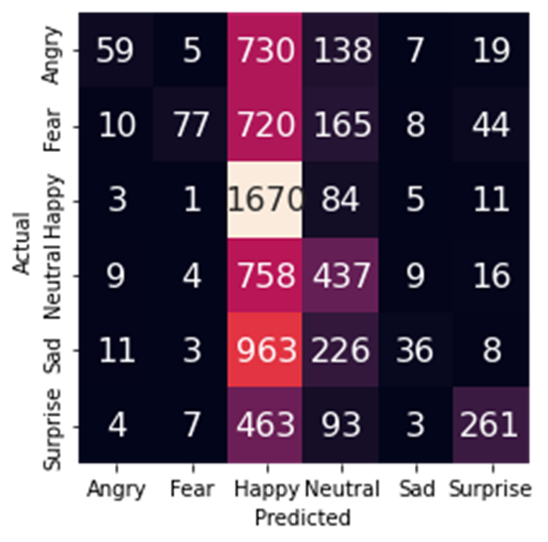
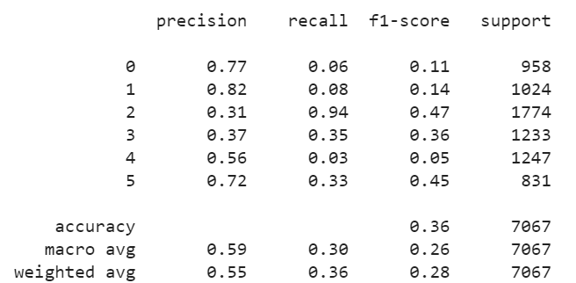
Confusion Matrix
Classification Report as per class

Slide 13
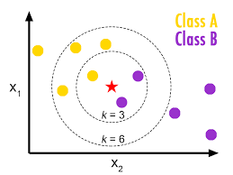
K Nearest Neighbours
K-NN algorithm stores all the available data and classifies a new data point based on the similarity. This means when new data appears then it can be easily classified into a well suite category by using K- NN algorithm.
Tuned Hyperparameter :
K : 121
Evaluation Metrics for KNN:
Precision: 0.36
Recall: 0.28
F1 score: 0.26
Accuracy: 0.325

Slide 14
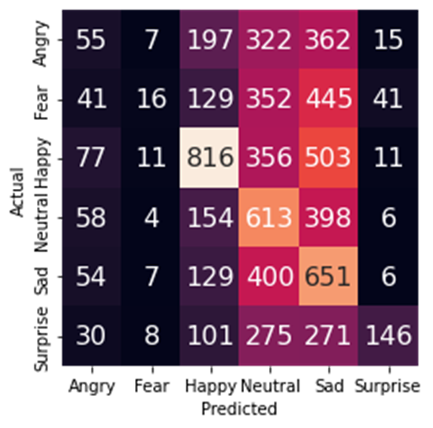
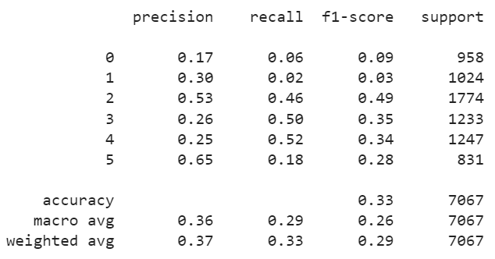
K Nearest Neighbours (contd)
Confusion Matrix
Classification Report as per class

Slide 15
Gaussian Naïve bayes
Gaussian Naïve bayes is based on Bayes theorem which supports continuous values and has an assumption that each class is normally distributed.
Hyperparameter Tuning:
Var_smoothing: np.logspace(10,-30, num=10)
Cross validation: Stratified K fold with 20 splits
Evaluation Metrics for Gaussian Naïve bayes :
Precision: 0.26
Recall: 0.21
F1 score: 0.13
Accuracy: 0.29

Slide 16
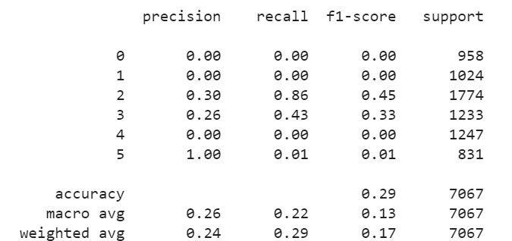
Classification Report as per class

Slide 17
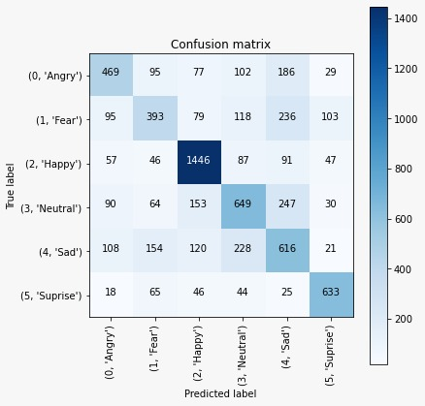
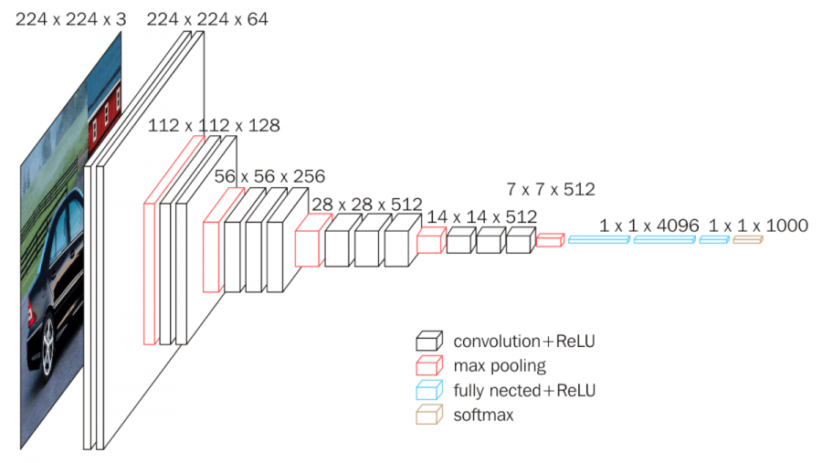
Convolutional Neural Networks – VGG16
A Convolutional Neural Network (ConvNet/CNN) is a Deep Learning algorithm which can take in an input image, assign importance (learnable weights and biases) to various aspects/objects in the image and be able to differentiate one from the other. One of the best computer vision models to date, the VGG16 model has 16 convolutional layers.
Evaluation Metrics:
Test Accuracy: 60 %

Slide 18
Conclusion
It can be seen that the VGG16 model gave the best test accuracy of 60%
This model was trained over 25 epochs and had given a train accuracy of 95.21%
The major drawback of the model is the time it trains to train and process the model.
The second best model (one with lower training time) as from the models used was the Random Forest model which had a test accuracy of 35%

